Slide 1

iPad Information session for
Year 4 2026 students

Slide 2
Supported iPad Models
Standard iPads:
  9th Generation or newer
iPad Air:
  5th Generation or newer
iPad Pro:
  5th Generation or newer
Notes:
Braydn, is this still the latest?

Slide 3
10th Generation Changes
Charger has changed from Lightning to USB-C
Removed the Headphone Port
  Will require an adapter (3.5mm -> USB-C)
  Official Apple adapter approx. $15
Notes:
Braydn, is this still the latest?

Slide 4

Cases and Protection
Popular Retailers
  Officeworks
  JB HiFi
  Harvey Norman
mycasecovers.com.au
stmgoods.com.au
Some come with keyboards – purely your choice to purchase

Slide 5
Cases and Protection
iPad 7/8/9th Generation – 10.2 Inch
iPad 10th/11th Generation – 10.9 Inch
Case must protect the corners and edges
Only tempered glass screen protectors are worth buying
AppleCare will provide 2 years of accidental damage protection subject to $65 service fee
Notes:
Particular generation/models with have certain cases – make sure you purchase the correct case for the model you have.

Slide 6
iPad enrolment
We use a program called Intune to enrol iPads onto the school network. This program configures the Wi-Fi settings and simplifies the process of installing apps.
Notes:
We use a program called Intune to enrol iPads onto the school network. This program configures the Wi-Fi settings and simplifies the process of installing apps.

Slide 7
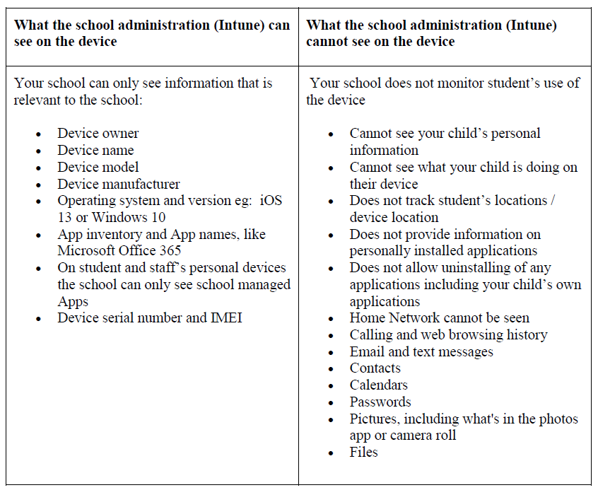
App management
Notes:
This table outlines what information is visible to us and what remains private, providing a clear breakdown of privacy details.

Slide 8
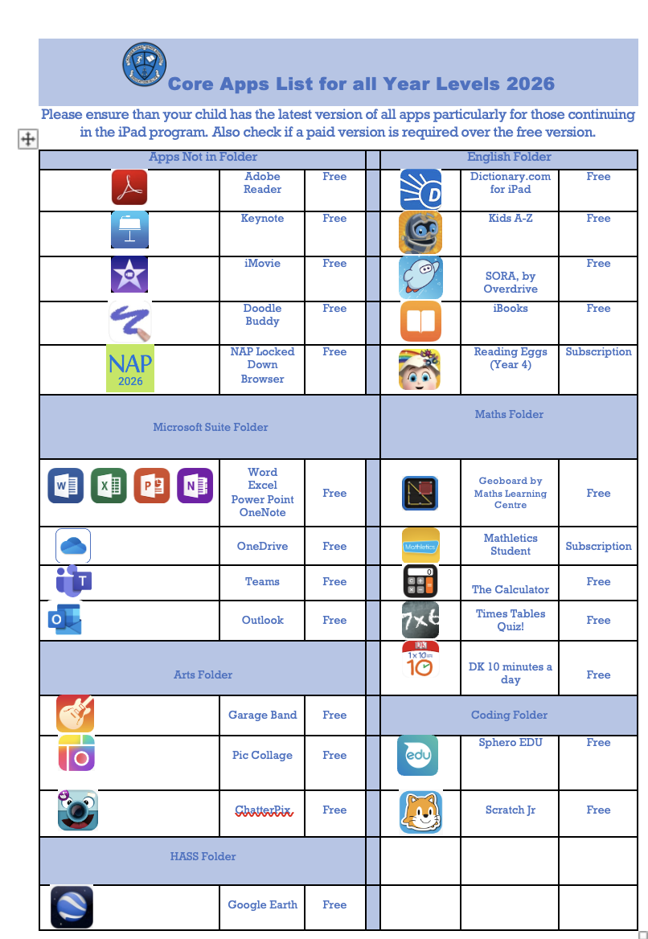
Core Apps for 2026
Notes:
Deb, Talk to Braydn about what new apps might be needed on this doc. This will need updating on G Drive and on website

Slide 9
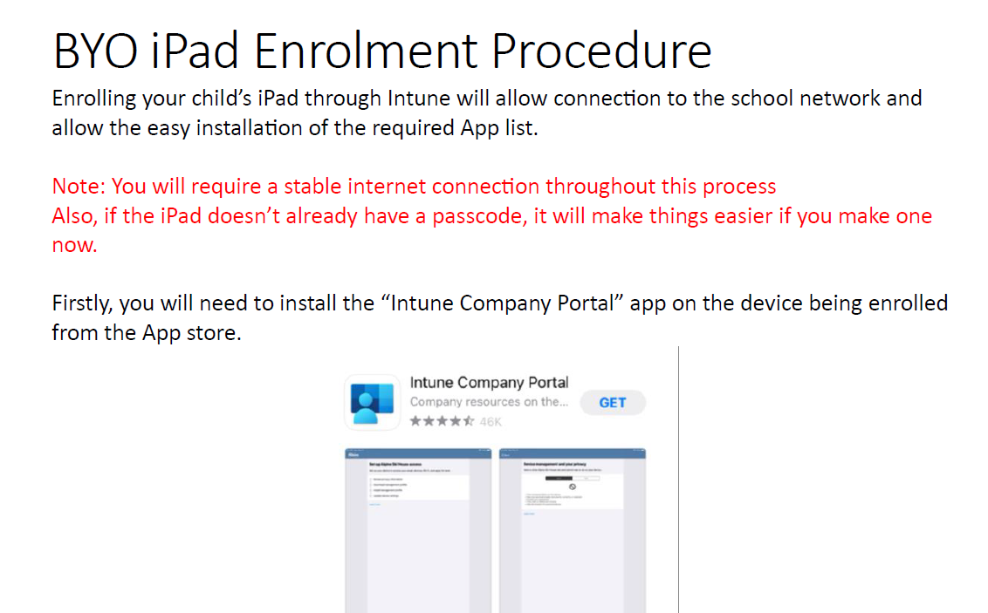
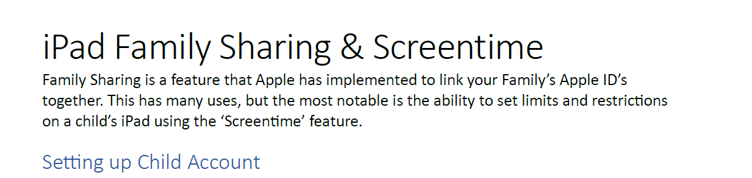
Go to Guides
Notes:
Go to Guides will be sent to you electronically.

Slide 10

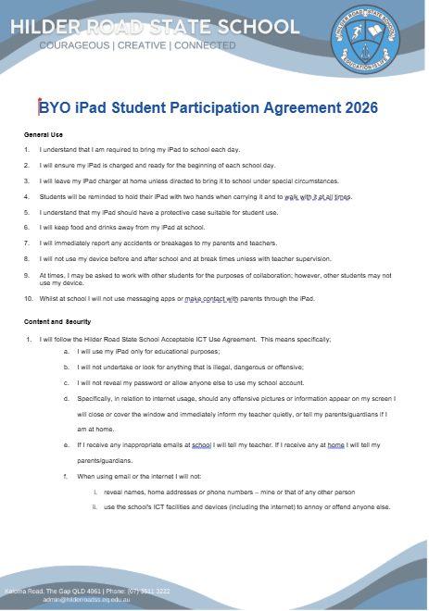
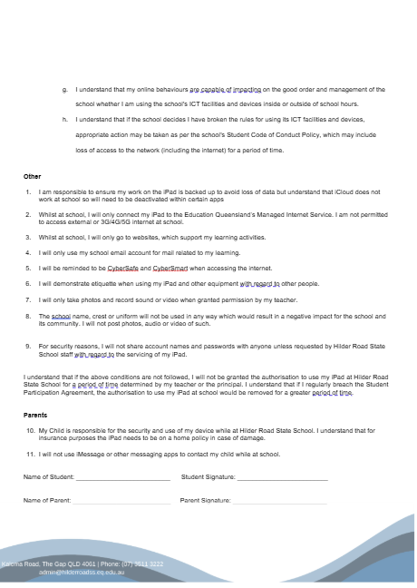
BYOD iPad Agreement
Notes:
All forms will need to be signed and returned to school during the first week of school in 2025. Please bring the forms to the office or hand to your classroom teacher. DEB – This will need updating on G Drive and on website

Slide 11

HRSS iPad Charter
Notes:
All families will receive a HRSS iPad charter document – this outlines our policy and procedures or the BYDO program.
DEB – This will need updating on G Drive and on website

Slide 12
Key dates for 2025/2026:
Wednesday, November 5th 4.00pm – BYOD iPad information session for current Yr 3 parents.
Thursday, January 29th – Years 4, 5 & 6 students to bring their iPad and ALL paperwork must be returned.
February – All students and families in Years 4-6 to participate in Cybersafety Program (delivered by 'Think you Know') date to be confirmed.
Notes:
Deb, Any known dates need to be altered for the last 4 items.

Slide 13
Question time
For any technical questions, feel free to email Braydn at: bcraw82@eq.edu.au
Notes:
Thank you for coming!

